Slide 1
Subject : Data Structures & Algorithms
Lecture : 6
In the Name of Allah the Most Beneficent the Most Merciful

Slide 2
Evaluating Postfix
Evaluate 6 2 3 + - 3 8 2 / + * 2 ↑ 3 +
Input op1 op2 value stack
6 6
Notes:
A primary concern for this course is efficiency.
You might believe that faster computers make it unnecessary to be concerned with efficiency. However…
So we need special training.

Slide 3
Evaluating Postfix
Evaluate 6 2 3 + - 3 8 2 / + * 2 ↑ 3 +
Input op1 op2 value stack
6 6
2 6,2
Notes:
A primary concern for this course is efficiency.
You might believe that faster computers make it unnecessary to be concerned with efficiency. However…
So we need special training.

Slide 4
Evaluating Postfix
Evaluate 6 2 3 + - 3 8 2 / + * 2 ↑ 3 +
Input op1 op2 value stack
6 6
2 6,2
3 6,2,3
Notes:
A primary concern for this course is efficiency.
You might believe that faster computers make it unnecessary to be concerned with efficiency. However…
So we need special training.

Slide 5
Evaluating Postfix
Evaluate 6 2 3 + - 3 8 2 / + * 2 ↑ 3 +
Input op1 op2 value stack
6 6
2 6,2
3 6,2,3
+ 2 3 5 6,5
Notes:
A primary concern for this course is efficiency.
You might believe that faster computers make it unnecessary to be concerned with efficiency. However…
So we need special training.

Slide 6
Evaluating Postfix
Evaluate 6 2 3 + - 3 8 2 / + * 2 ↑ 3 +
Input op1 op2 value stack
6 6
2 6,2
3 6,2,3
+ 2 3 5 6,5
- 6 5 1 1
Notes:
A primary concern for this course is efficiency.
You might believe that faster computers make it unnecessary to be concerned with efficiency. However…
So we need special training.

Slide 7
Evaluating Postfix
Evaluate 6 2 3 + - 3 8 2 / + * 2 ↑ 3 +
Input op1 op2 value stack
6 6
2 6,2
3 6,2,3
+ 2 3 5 6,5
- 6 5 1 1
3 6 5 1 1,3
Notes:
A primary concern for this course is efficiency.
You might believe that faster computers make it unnecessary to be concerned with efficiency. However…
So we need special training.

Slide 8
Evaluating Postfix
Evaluate 6 2 3 + - 3 8 2 / + * 2 ↑ 3 +
Input op1 op2 value stack
6 6
2 6,2
3 6,2,3
+ 2 3 5 6,5
- 6 5 1 1
3 6 5 1 1,3
8 6 5 1 1,3,8
Notes:
A primary concern for this course is efficiency.
You might believe that faster computers make it unnecessary to be concerned with efficiency. However…
So we need special training.

Slide 9
Evaluating Postfix
Evaluate 6 2 3 + - 3 8 2 / + * 2 ↑ 3 +
Input op1 op2 value stack
6 6
2 6,2
3 6,2,3
+ 2 3 5 6,5
- 6 5 1 1
3 6 5 1 1,3
8 6 5 1 1,3,8
2 6 5 1 1,3,8,2
Notes:
A primary concern for this course is efficiency.
You might believe that faster computers make it unnecessary to be concerned with efficiency. However…
So we need special training.

Slide 10
Evaluating Postfix
Evaluate 6 2 3 + - 3 8 2 / + * 2 ↑ 3 +
Input op1 op2 value stack
6 6
2 6,2
3 6,2,3
+ 2 3 5 6,5
- 6 5 1 1
3 6 5 1 1,3
8 6 5 1 1,3,8
2 6 5 1 1,3,8,2
/ 8 2 4 1,3,4
Notes:
A primary concern for this course is efficiency.
You might believe that faster computers make it unnecessary to be concerned with efficiency. However…
So we need special training.

Slide 11
Evaluating Postfix
Evaluate 6 2 3 + - 3 8 2 / + * 2 ↑ 3 +
Input op1 op2 value stack
6 6
2 6,2
3 6,2,3
+ 2 3 5 6,5
- 6 5 1 1
3 6 5 1 1,3
8 6 5 1 1,3,8
2 6 5 1 1,3,8,2
/ 8 2 4 1,3,4
+ 3 4 7 1,7
Notes:
A primary concern for this course is efficiency.
You might believe that faster computers make it unnecessary to be concerned with efficiency. However…
So we need special training.

Slide 12
Evaluating Postfix
Evaluate 6 2 3 + - 3 8 2 / + * 2 ↑ 3 +
Input op1 op2 value stack
6 6
2 6,2
3 6,2,3
+ 2 3 5 6,5
- 6 5 1 1
3 6 5 1 1,3
8 6 5 1 1,3,8
2 6 5 1 1,3,8,2
/ 8 2 4 1,3,4
+ 3 4 7 1,7
* 1 7 7 7
Notes:
A primary concern for this course is efficiency.
You might believe that faster computers make it unnecessary to be concerned with efficiency. However…
So we need special training.

Slide 13
Evaluating Postfix
Evaluate 6 2 3 + - 3 8 2 / + * 2 ↑ 3 +
Input op1 op2 value stack
6 6
2 6,2
3 6,2,3
+ 2 3 5 6,5
- 6 5 1 1
3 6 5 1 1,3
8 6 5 1 1,3,8
2 6 5 1 1,3,8,2
/ 8 2 4 1,3,4
+ 3 4 7 1,7
* 1 7 7 7
2 1 7 7 7,2
Notes:
A primary concern for this course is efficiency.
You might believe that faster computers make it unnecessary to be concerned with efficiency. However…
So we need special training.

Slide 14
Evaluating Postfix
Evaluate 6 2 3 + - 3 8 2 / + * 2 ↑ 3 +
Input op1 op2 value stack
6 6
2 6,2
3 6,2,3
+ 2 3 5 6,5
- 6 5 1 1
3 6 5 1 1,3
8 6 5 1 1,3,8
2 6 5 1 1,3,8,2
/ 8 2 4 1,3,4
+ 3 4 7 1,7
* 1 7 7 7
2 1 7 7 7,2
↑ 7 2 49 49
Notes:
A primary concern for this course is efficiency.
You might believe that faster computers make it unnecessary to be concerned with efficiency. However…
So we need special training.

Slide 15
Evaluating Postfix
Evaluate 6 2 3 + - 3 8 2 / + * 2 ↑ 3 +
Input op1 op2 value stack
6 6
2 6,2
3 6,2,3
+ 2 3 5 6,5
- 6 5 1 1
3 6 5 1 1,3
8 6 5 1 1,3,8
2 6 5 1 1,3,8,2
/ 8 2 4 1,3,4
+ 3 4 7 1,7
* 1 7 7 7
2 1 7 7 7,2
↑ 7 2 49 49
3 7 2 49 49,3
Notes:
A primary concern for this course is efficiency.
You might believe that faster computers make it unnecessary to be concerned with efficiency. However…
So we need special training.

Slide 16
Evaluating Postfix
Evaluate 6 2 3 + - 3 8 2 / + * 2 ↑ 3 +
Input op1 op2 value stack
6 6
2 6,2
3 6,2,3
+ 2 3 5 6,5
- 6 5 1 1
3 6 5 1 1,3
8 6 5 1 1,3,8
2 6 5 1 1,3,8,2
/ 8 2 4 1,3,4
+ 3 4 7 1,7
* 1 7 7 7
2 1 7 7 7,2
↑ 7 2 49 49
3 7 2 49 49,3
+ 49 3 52 52
Notes:
A primary concern for this course is efficiency.
You might believe that faster computers make it unnecessary to be concerned with efficiency. However…
So we need special training.

Slide 17
Evaluating Postfix
Evaluate 6 2 3 + - 3 8 2 / + * 2 ↑ 3 +
Input op1 op2 value stack
6 6
2 6,2
3 6,2,3
+ 2 3 5 6,5
- 6 5 1 1
3 6 5 1 1,3
8 6 5 1 1,3,8
2 6 5 1 1,3,8,2
/ 8 2 4 1,3,4
+ 3 4 7 1,7
* 1 7 7 7
2 1 7 7 7,2
↑ 7 2 49 49
3 7 2 49 49,3
+ 49 3 52 52
Notes:
A primary concern for this course is efficiency.
You might believe that faster computers make it unnecessary to be concerned with efficiency. However…
So we need special training.

Slide 18
Converting Infix to Postfix
Consider the infix expressions ‘A+B*C’ and ‘ (A+B)*C’.
The postfix versions are ‘ABC*+’ and ‘AB+C*’.
The order of operands in postfix is the same as the infix.
In scanning from left to right, the operand ‘A’ can be inserted into postfix expression.
Notes:
A primary concern for this course is efficiency.
You might believe that faster computers make it unnecessary to be concerned with efficiency. However…
So we need special training.

Slide 19
Converting Infix to Postfix
The ‘+’ cannot be inserted until its second operand has been scanned and inserted.
The ‘+’ has to be stored away until its proper position is found.
When ‘B’ is seen, it is immediately inserted into the postfix expression.
Can the ‘+’ be inserted now? In the case of ‘A+B*C’ cannot because * has precedence.
Notes:
A primary concern for this course is efficiency.
You might believe that faster computers make it unnecessary to be concerned with efficiency. However…
So we need special training.

Slide 20
Converting Infix to Postfix
In case of ‘(A+B)*C’, the closing parenthesis indicates that ‘+’ must be performed first.
Assume the existence of a function ‘prcd(op1,op2)’ where op1 and op2 are two operators.
Prcd(op1,op2) returns TRUE if op1 has precedence over op2, FASLE otherwise.
Notes:
A primary concern for this course is efficiency.
You might believe that faster computers make it unnecessary to be concerned with efficiency. However…
So we need special training.

Slide 21
Converting Infix to Postfix
prcd(‘*’,’+’) is TRUE
prcd(‘+’,’+’) is TRUE
prcd(‘+’,’*’) is FALSE
Here is the algorithm that converts infix expression to its postfix form.
The infix expression is without parenthesis.
Notes:
A primary concern for this course is efficiency.
You might believe that faster computers make it unnecessary to be concerned with efficiency. However…
So we need special training.

Slide 22
Converting Infix to Postfix
Example: A + B * C
symb postfix stack
A A
Notes:
A primary concern for this course is efficiency.
You might believe that faster computers make it unnecessary to be concerned with efficiency. However…
So we need special training.

Slide 23
Converting Infix to Postfix
Example: A + B * C
symb postfix stack
A A
+ A +
Notes:
A primary concern for this course is efficiency.
You might believe that faster computers make it unnecessary to be concerned with efficiency. However…
So we need special training.

Slide 24
Converting Infix to Postfix
Example: A + B * C
symb postfix stack
A A
+ A +
B AB +
Notes:
A primary concern for this course is efficiency.
You might believe that faster computers make it unnecessary to be concerned with efficiency. However…
So we need special training.

Slide 25
Converting Infix to Postfix
Example: A + B * C
symb postfix stack
A A
+ A +
B AB +
* AB + *
Notes:
A primary concern for this course is efficiency.
You might believe that faster computers make it unnecessary to be concerned with efficiency. However…
So we need special training.

Slide 26
Converting Infix to Postfix
Example: A + B * C
symb postfix stack
A A
+ A +
B AB +
* AB + *
C ABC + *
Notes:
A primary concern for this course is efficiency.
You might believe that faster computers make it unnecessary to be concerned with efficiency. However…
So we need special training.

Slide 27
Converting Infix to Postfix
Example: A + B * C
symb postfix stack
A A
+ A +
B AB +
* AB + *
C ABC + *
ABC * +
Notes:
A primary concern for this course is efficiency.
You might believe that faster computers make it unnecessary to be concerned with efficiency. However…
So we need special training.

Slide 28
Converting Infix to Postfix
Example: A * B + C
symb postfix stack
A A
* A
B AB +
* AB + *
C ABC + *
ABC * +
ABC * +
Notes:
A primary concern for this course is efficiency.
You might believe that faster computers make it unnecessary to be concerned with efficiency. However…
So we need special training.

Slide 29
Converting Infix to Postfix
Handling parenthesis
When an open parenthesis ‘(‘ is read, it must be pushed on the stack.
This can be done by setting prcd(op,‘(‘ ) to be FALSE.
Also, prcd( ‘(‘,op ) == FALSE which ensures that an operator after ‘(‘ is pushed on the stack.
Notes:
A primary concern for this course is efficiency.
You might believe that faster computers make it unnecessary to be concerned with efficiency. However…
So we need special training.

Slide 30
Converting Infix to Postfix
When a ‘)’ is read, all operators up to the first ‘(‘ must be popped and placed in the postfix string.
To do this, prcd( op,’)’ ) == TRUE.
Both the ‘(‘ and the ‘)’ must be discarded: prcd( ‘(‘,’)’ ) == FALSE.
Need to change line 11 of the algorithm.
Notes:
A primary concern for this course is efficiency.
You might believe that faster computers make it unnecessary to be concerned with efficiency. However…
So we need special training.

Slide 31
Converting Infix to Postfix
Example: (A + B) * C
symb postfix stack
( (
A A (
+ A ( +
B AB ( +
) AB +
* AB + *
C AB + C *
AB + C *
Notes:
A primary concern for this course is efficiency.
You might believe that faster computers make it unnecessary to be concerned with efficiency. However…
So we need special training.

Slide 32
Converting Infix to Prefix
Example: A + B * C (Infix)
  Inverse: C * B + A
  Postfix of expression (a) using Stack: CB*A+
  Inverse of expression (b): +A*BC (Prefix)
Notes:
A primary concern for this course is efficiency.
You might believe that faster computers make it unnecessary to be concerned with efficiency. However…
So we need special training.

Slide 33
Converting Infix to Prefix
Example: (A + B) * C (Infix)
  Inverse: C * (B + A)
  Postfix of expression (a) using Stack: CBA+*
  Inverse of expression (b): *+ABC (Prefix)
Notes:
A primary concern for this course is efficiency.
You might believe that faster computers make it unnecessary to be concerned with efficiency. However…
So we need special training.

Slide 34
Function Call Stack
Stacks play a key role in implementation of function calls in programming languages.
In C++, for example, the “call stack” is used to pass function arguments and receive return values.
The call stack is also used for “local variables”

Slide 35
Call Stack
In GCC, a popular C/C++ compiler on Intel platform, stack entries are:
n*4(%esp)
last argument
……….
8(%esp)
second argument
4(%esp)
first argument
(%esp)
return address
top

Slide 36
Memory Organization
When a program (.exe) is run, it is loaded in memory. It becomes a process.
The process is given a block of memory.
[Control-Alt-DEL]
Process 1
(browser)
Process 3
(word)
Process 4
(excel)
Process 2
(dev-c++)
Windows OS

Slide 37
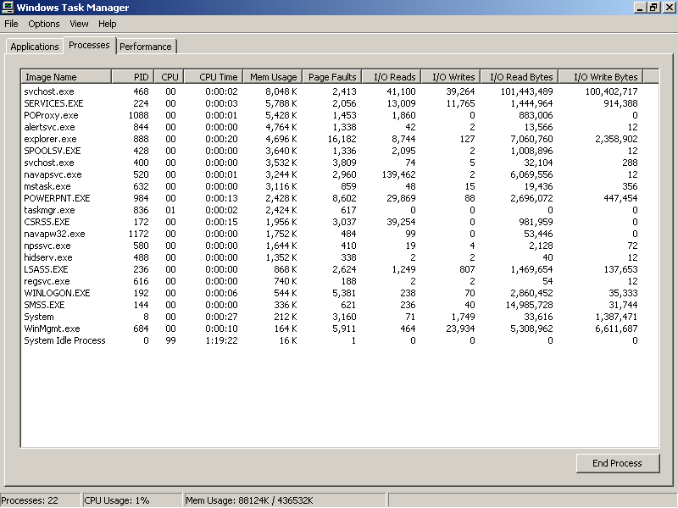
Task Manager

Slide 38
Memory Organization
Process 1
(browser)
Code
Process 3
(word)
Static data
Process 4
(excel)
Stack
Process 2
(dev-c++)
Windows OS
Heap
Notes:
End of lecture 8

Slide 39
Stack Layout during a call
Here is stack layout when function F calls function G:
Parameters(F)
Parameters(F)
Parameters(F)
Local variables(F)
Local variables(F)
Local variables(F)
Return address(F)
Return address(F)
Return address(F)
sp
Parameters(G)
Parameters(G)
sp
Local variables(G)
Return address(G)
sp
At point of call
During execution of G
After call

Slide 40
Stack Applications…
Finding Factorial
Tower of Hanoi
Stack use in compliers
  Translate infix expressions into some form of postfix notation
  Translate postfix expression into machine code
AL

Slide 41
Tower of Hanoi
The Tower of Hanoi (also called the Tower of Brahma is a mathematical game or puzzle. It consists of three rods, and a number of disks of different sizes which can slide onto any rod. The puzzle starts with the disks in a neat stack in ascending order of size on one rod, the smallest at the top, thus making a conical shape.
The objective of the puzzle is to move the entire stack to another rod, obeying the following simple rules:
Only one disk can be moved at a time.
Each move consists of taking the upper disk from one of the stacks and placing it on top of another stack i.e. a disk can only be moved if it is the uppermost disk on a stack.
No disk may be placed on top of a smaller disk.
With three disks, the puzzle can be solved in seven moves. The minimum number of moves required to solve a Tower of Hanoi puzzle is 2^{n} - 1, where n is the number of disks
AL

Slide 42
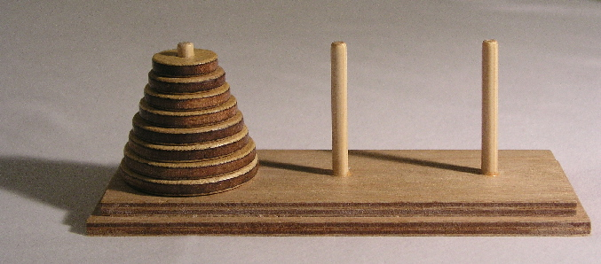
Tower of Hanoi
AL

Slide 43
Underflow & Overflow
When stack comes to its limit and yet another operation tries to PUSH data onto the stack then a 'stack overflow' occurs. When this happens it often causes the program to crash. It is up to the software programmer to ensure that the stack does not overflow.
If the stack is empty and yet a POP operation is attempted, this is called an 'stack underflow' and can cause a program to crash. The software programmer should check that the stack is not empty before attempting a POP operation.
AL

Slide 44
Summary
Stack
  Last In First Out (LIFO) data structure
  Implemented as array or linked list
  Arrays: limited number of elements
  Linked lists: allow dynamic element addition
Stack use in compliers
  Translate infix expressions into some form of postfix notation
  Translate postfix expression into machine code
Data Structures Using C++ 2E

